Slide 1
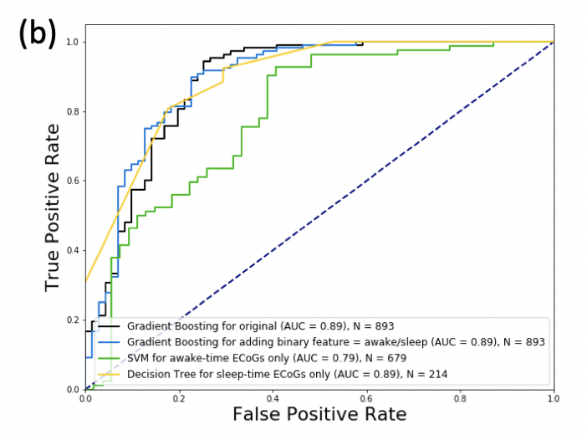
NY231 Without PLV features - ROC

Slide 2
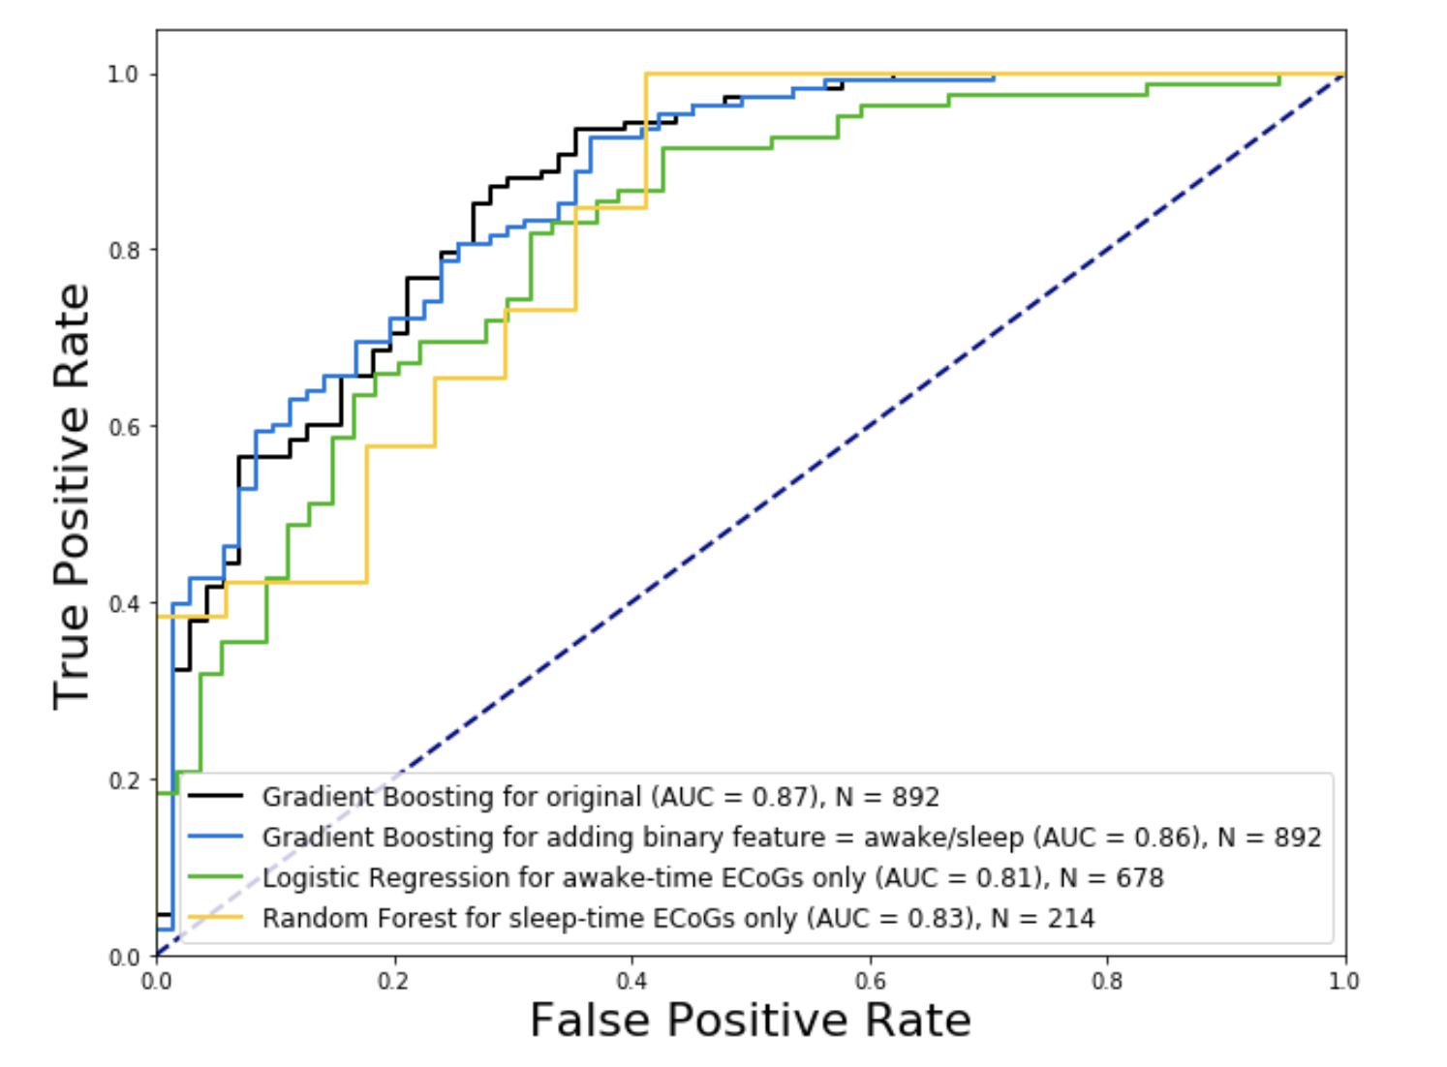
NY231 With PLV features - ROC

Slide 3
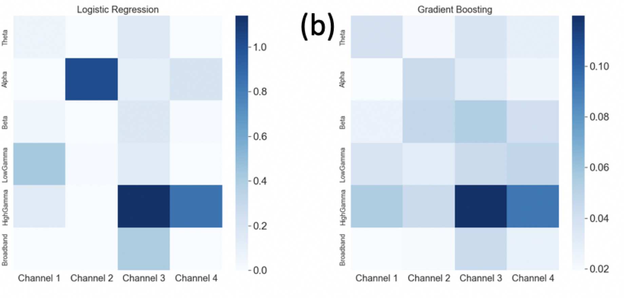
NY231 Without PLV features – feature importance, LR & GB

Slide 4
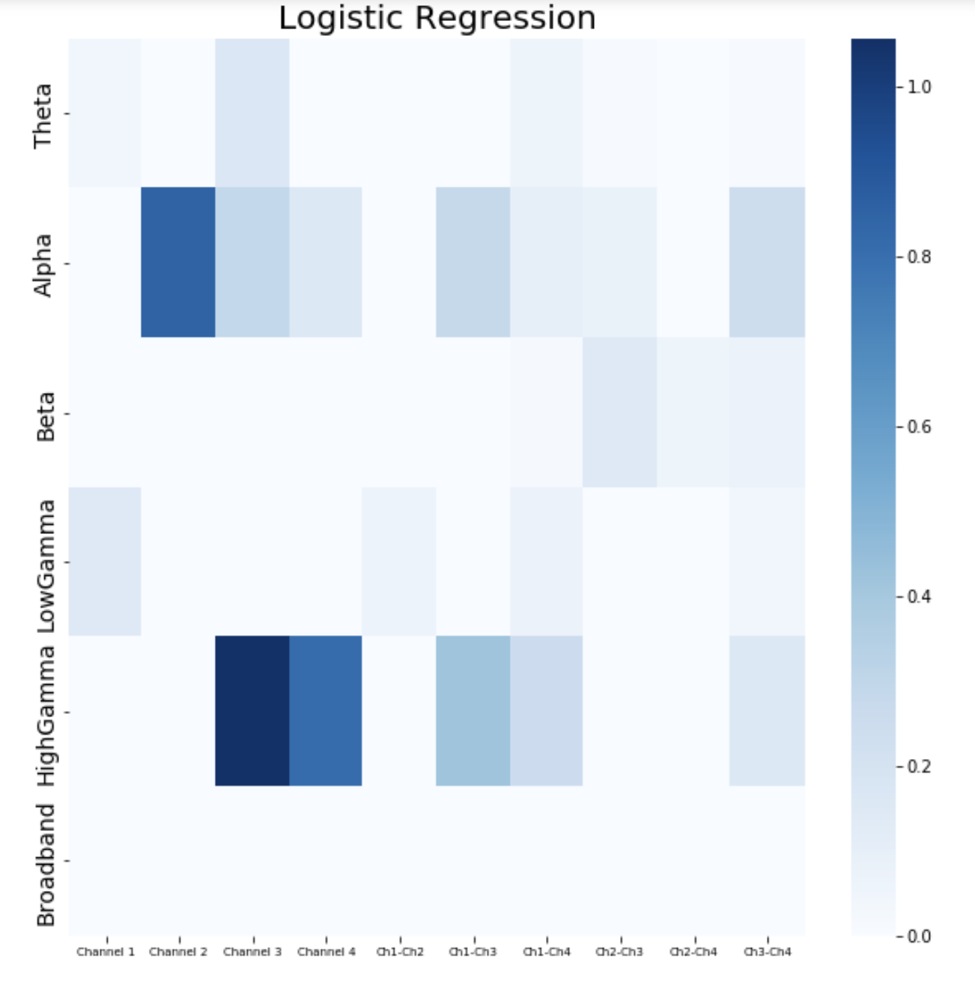
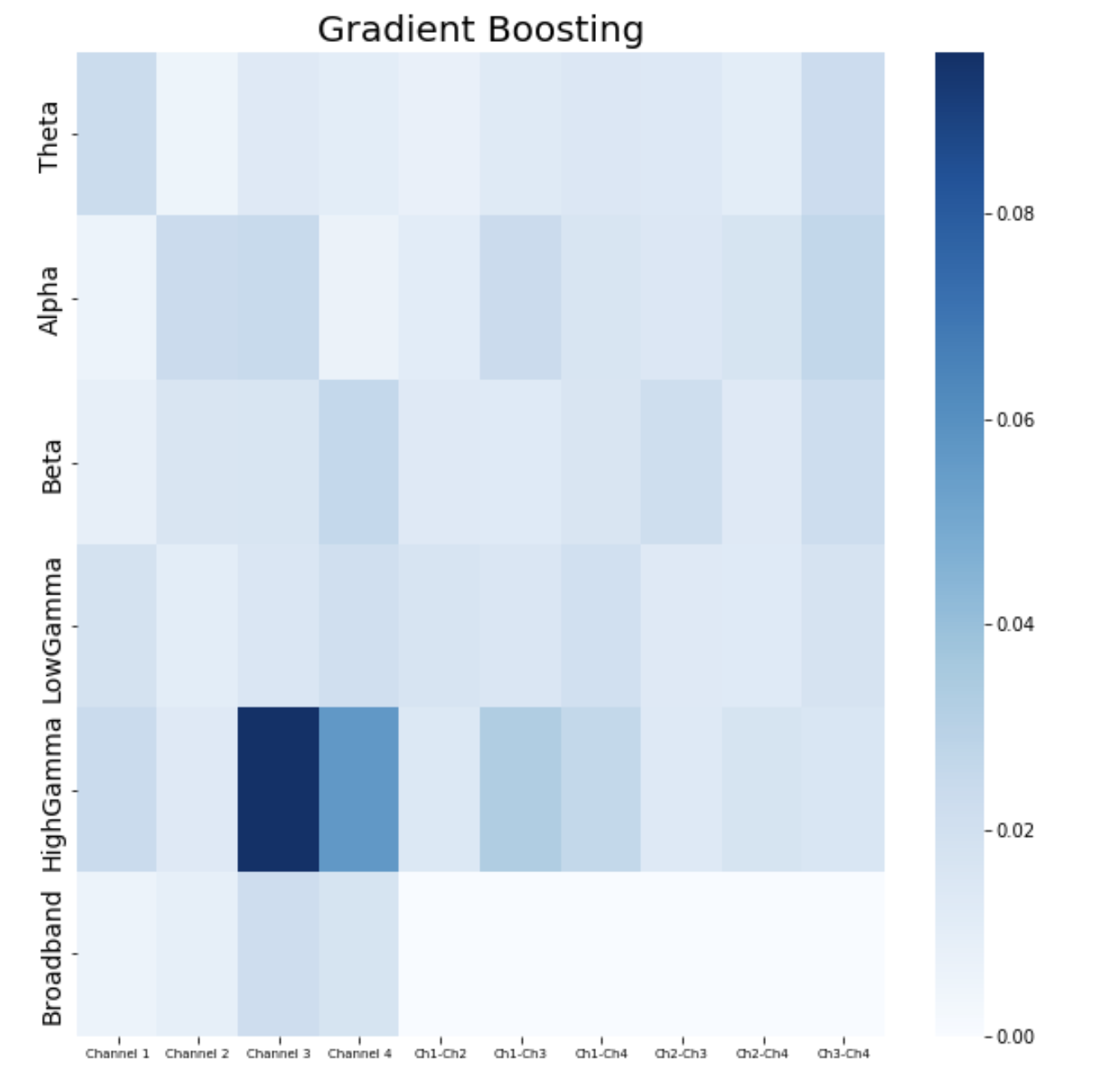
NY231 With PLV features – feature importance, LR & GB – ALL DATA

Slide 5
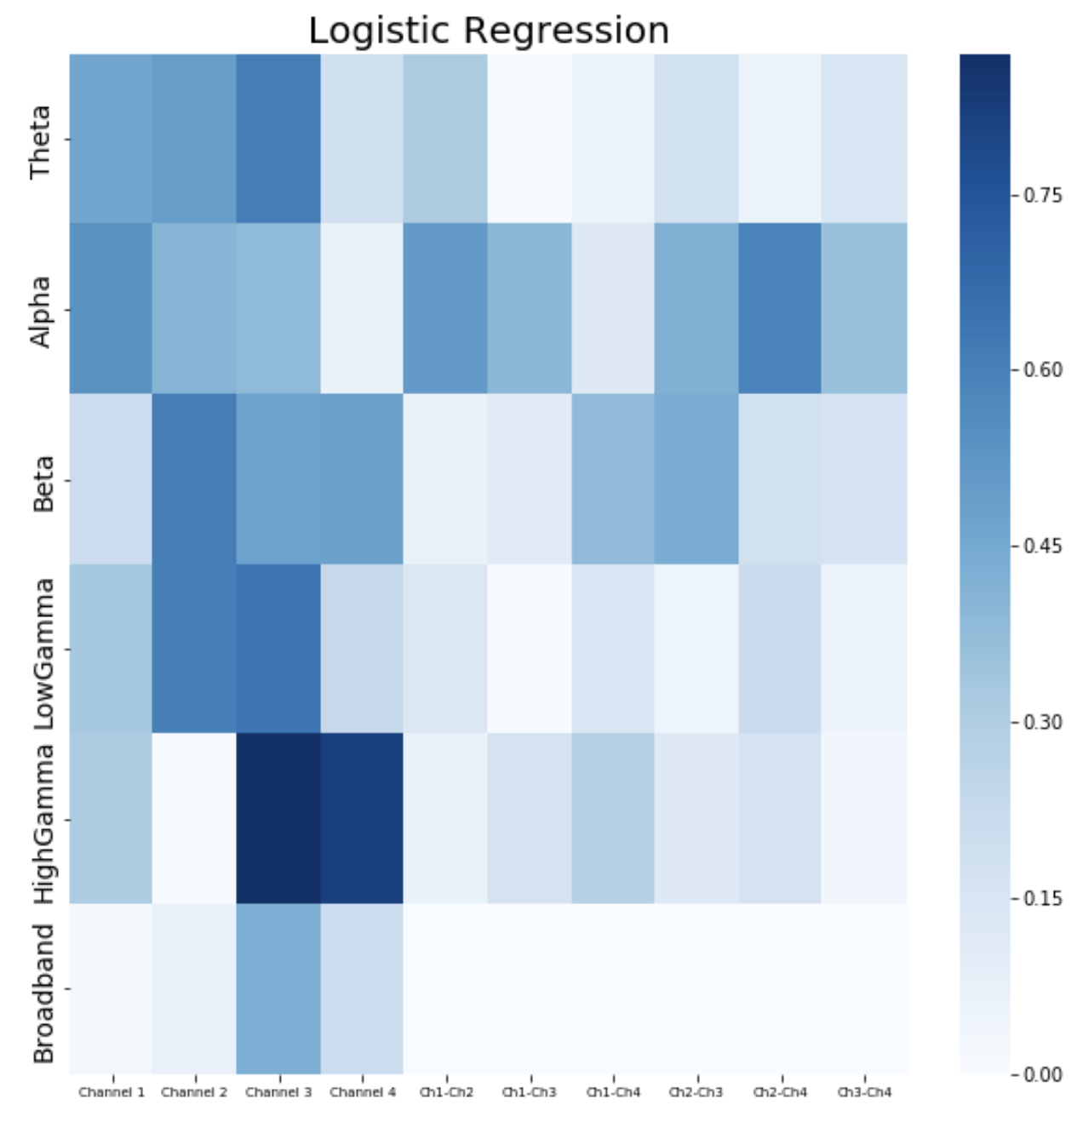
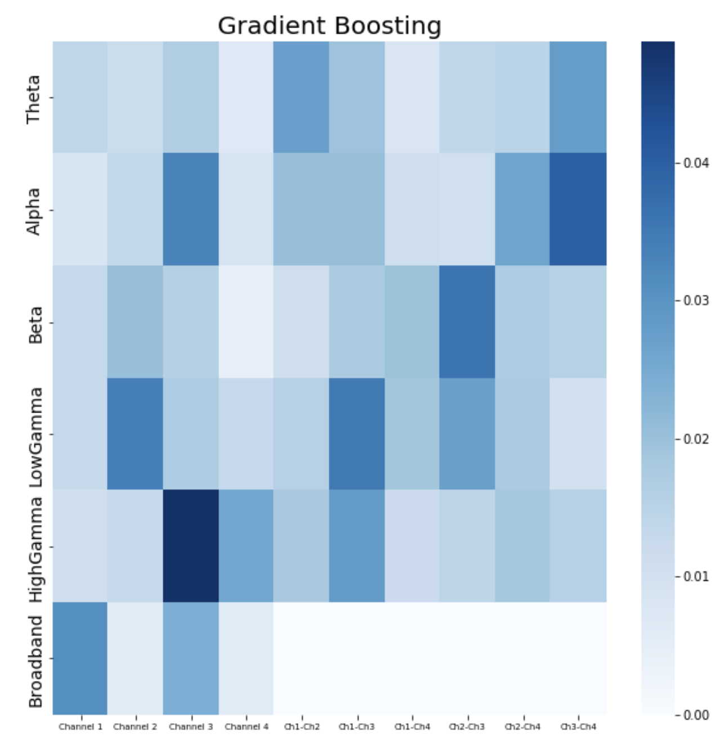
NY231 With PLV features – feature importance, LR & GB – ONLY SLEEP DATA

Slide 6
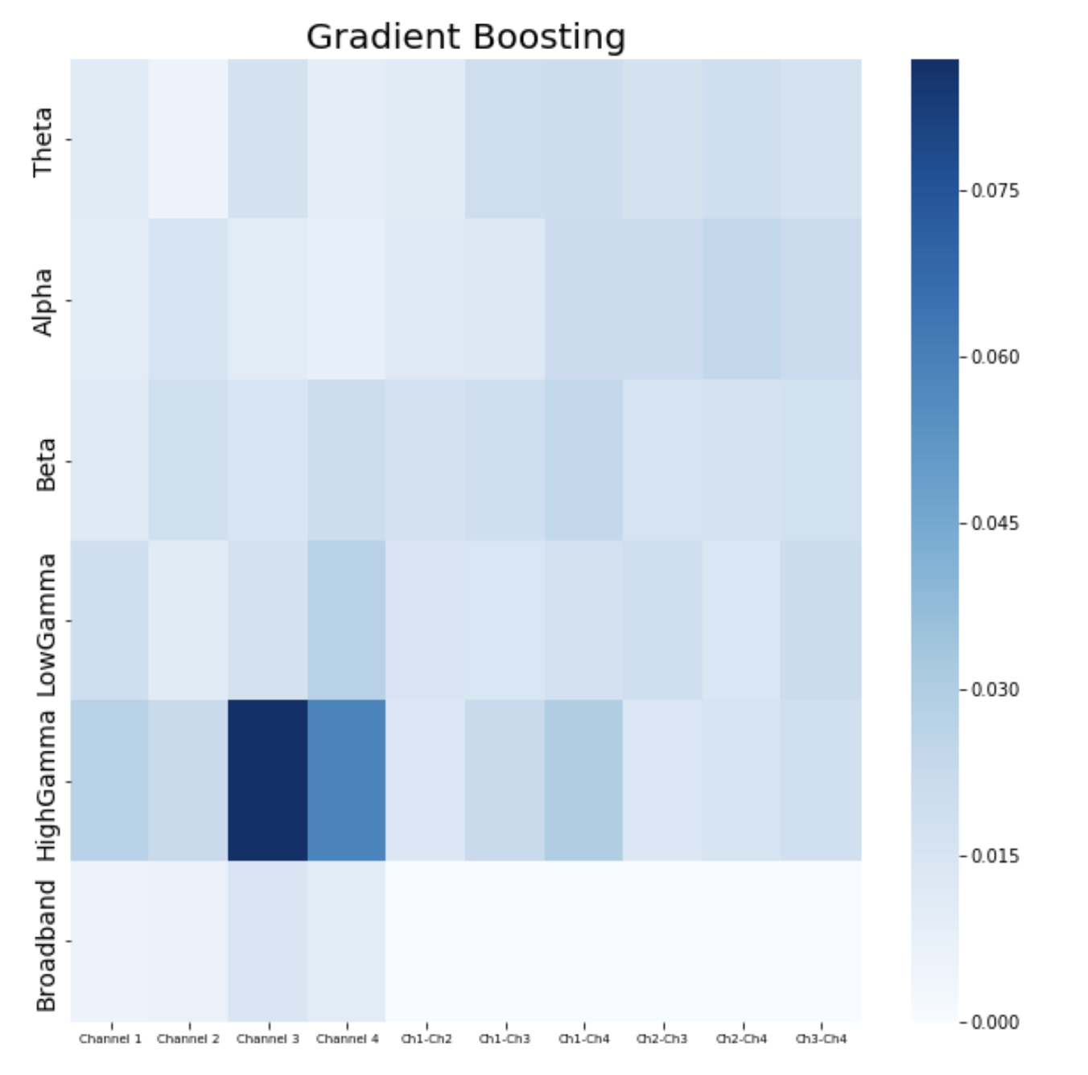
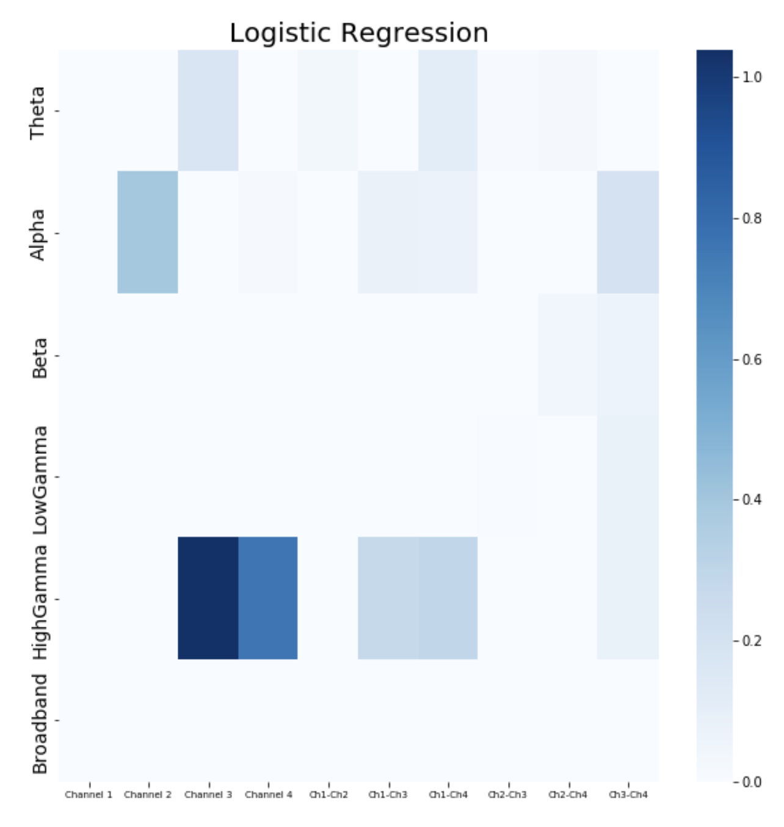
NY231 With PLV features – feature importance, LR & GB – ONLY AWAKE DATA

Slide 7
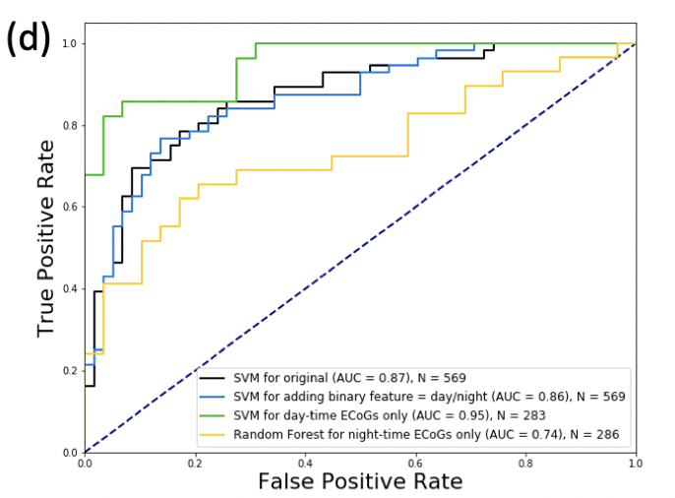
NY241 Without PLV features - ROC

Slide 8
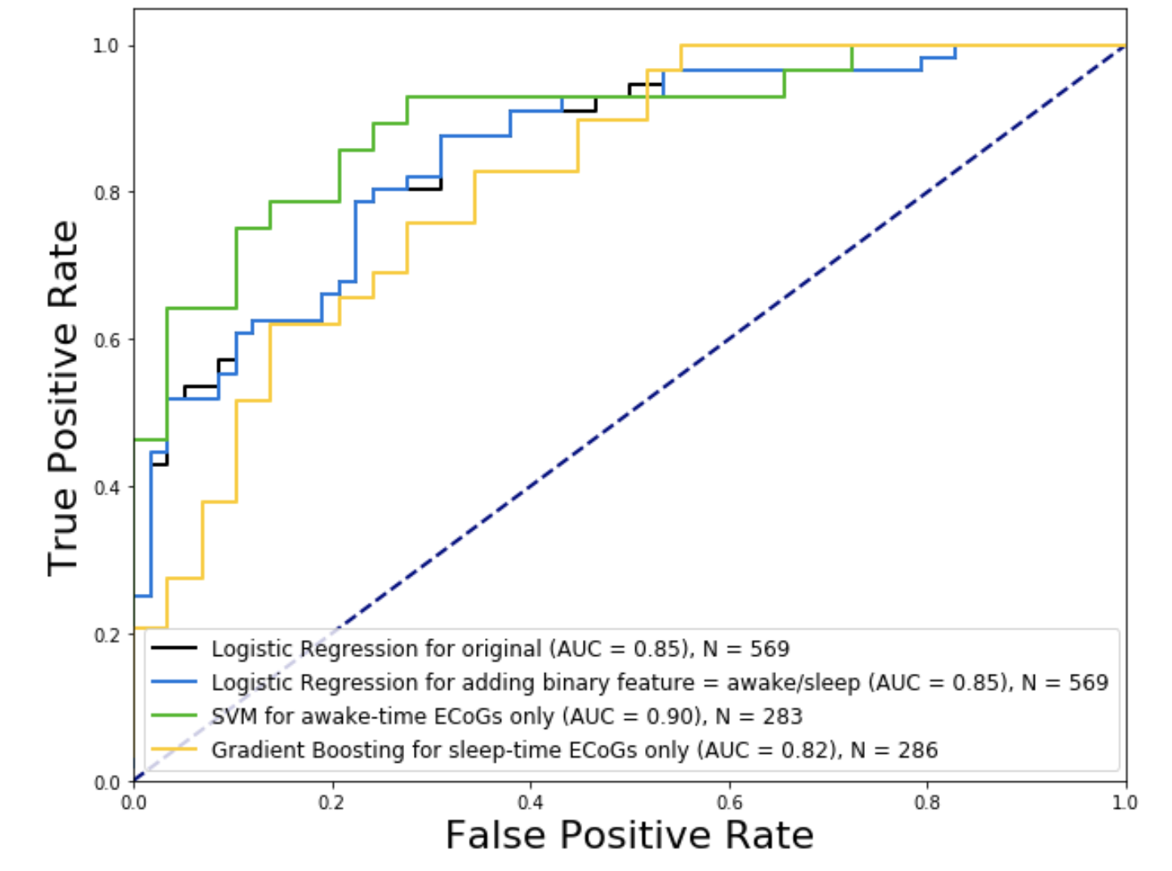
NY241 With PLV features - ROC

Slide 9
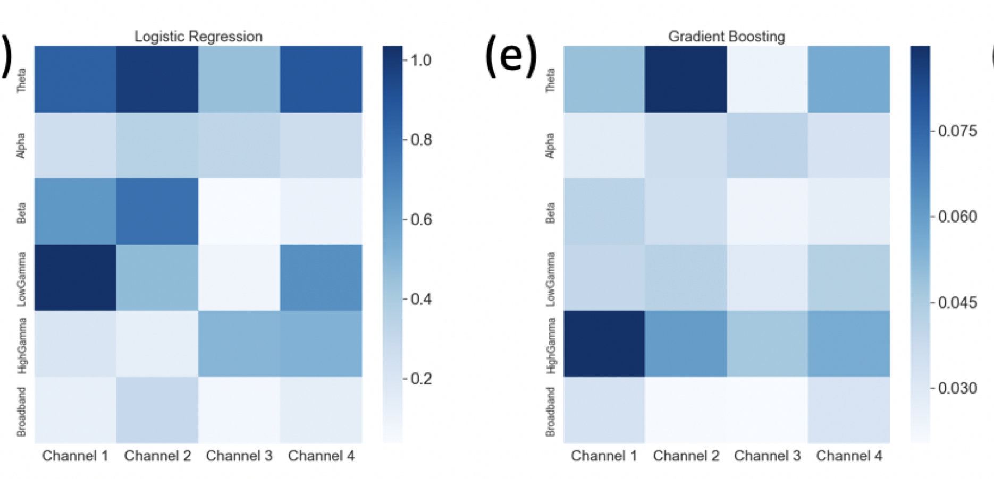
NY241 Without PLV features – feature importance, LR & GB

Slide 10
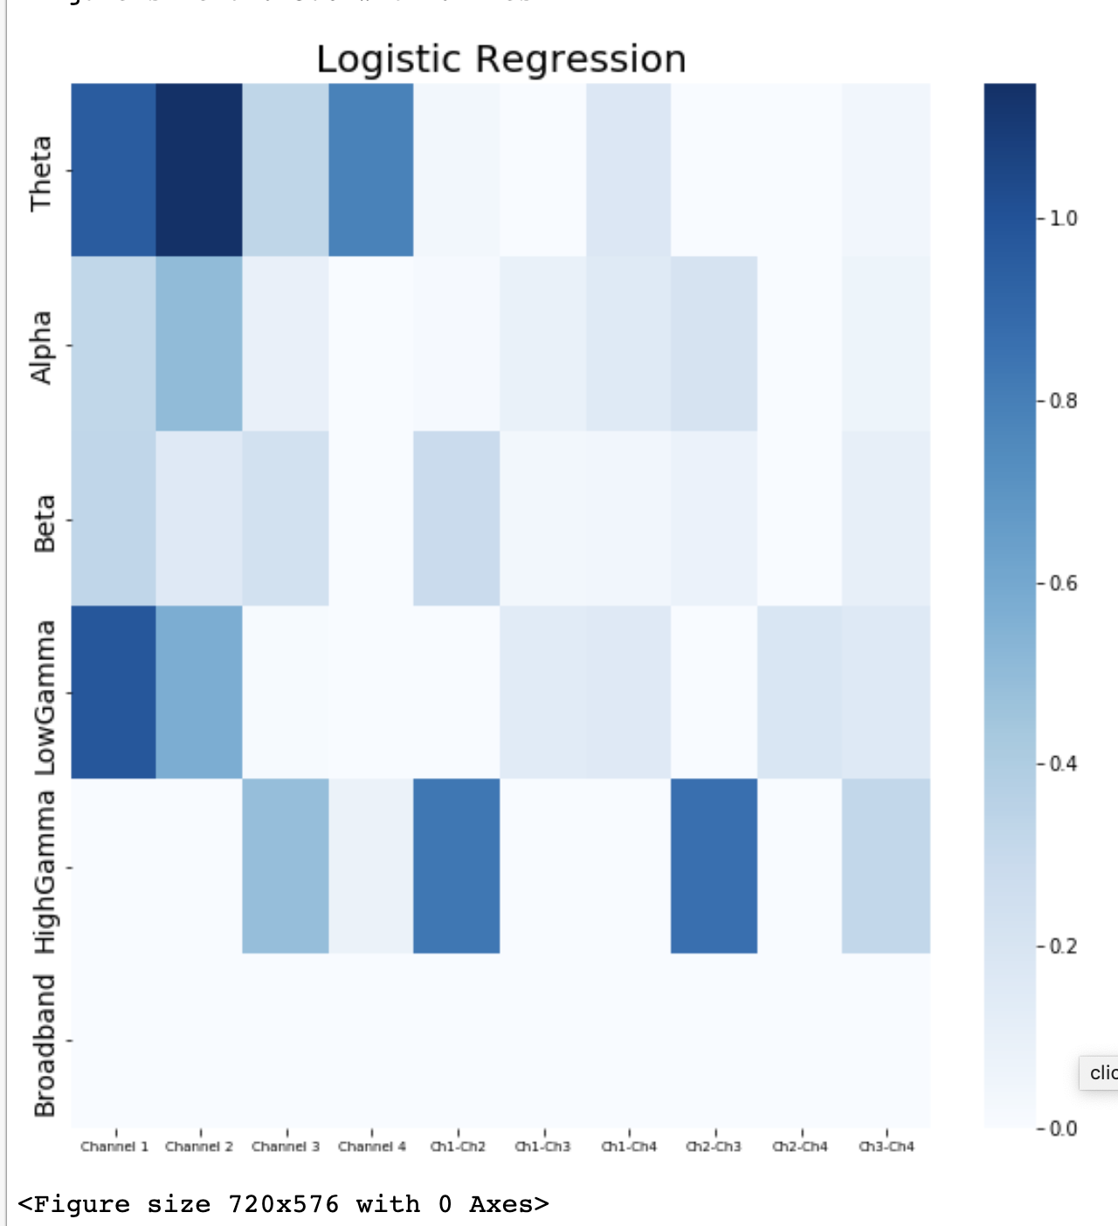
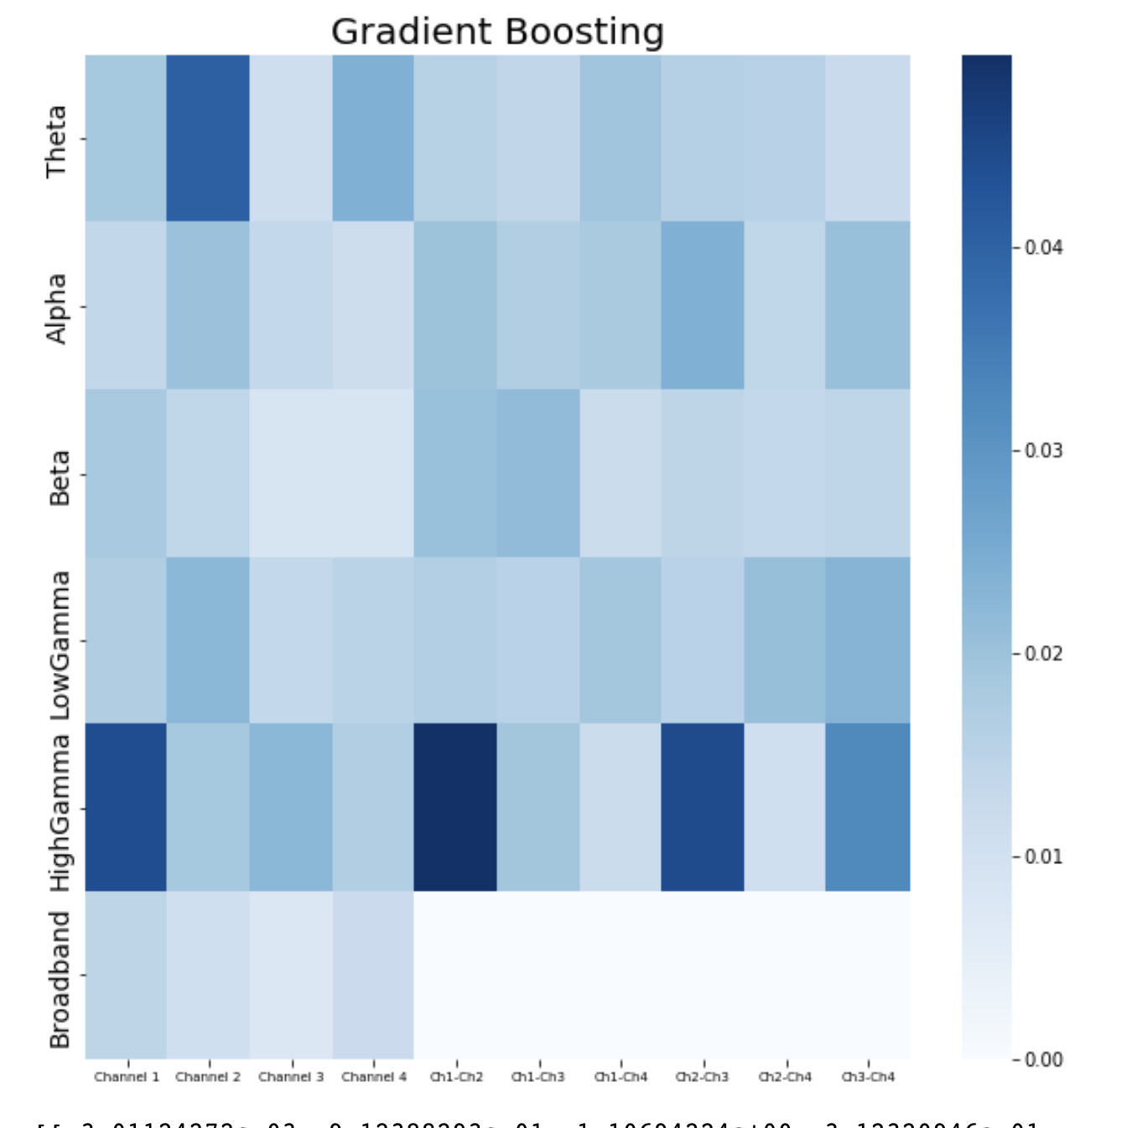
NY241 With PLV features – feature importance, LR & GB – ALL DATA

Slide 11
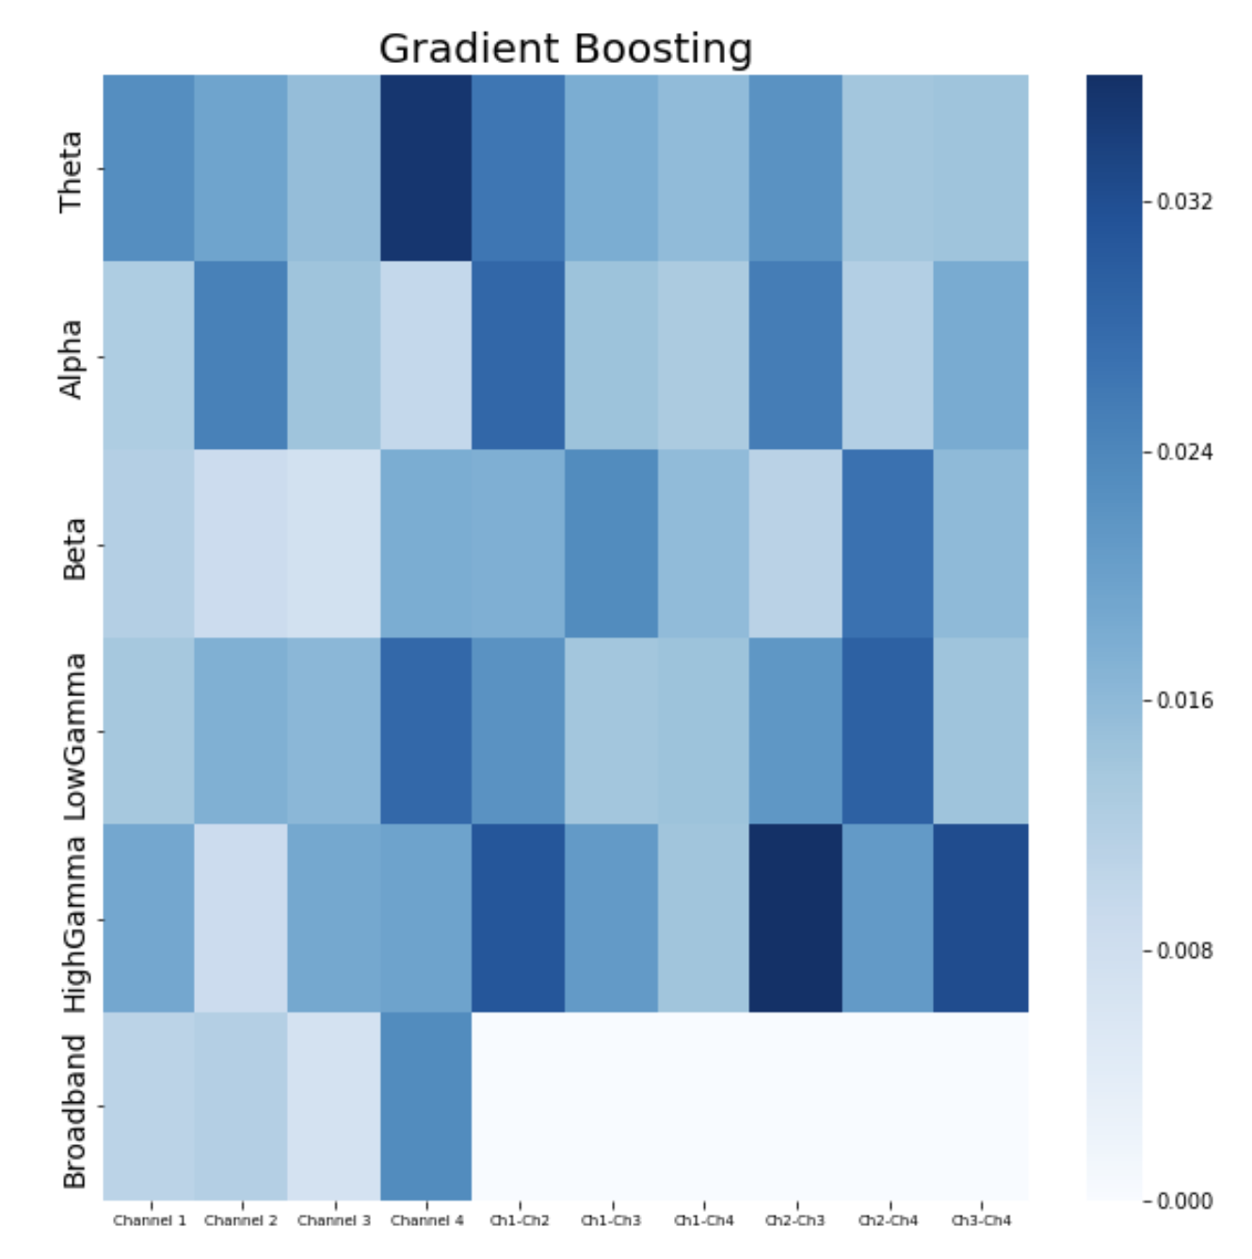
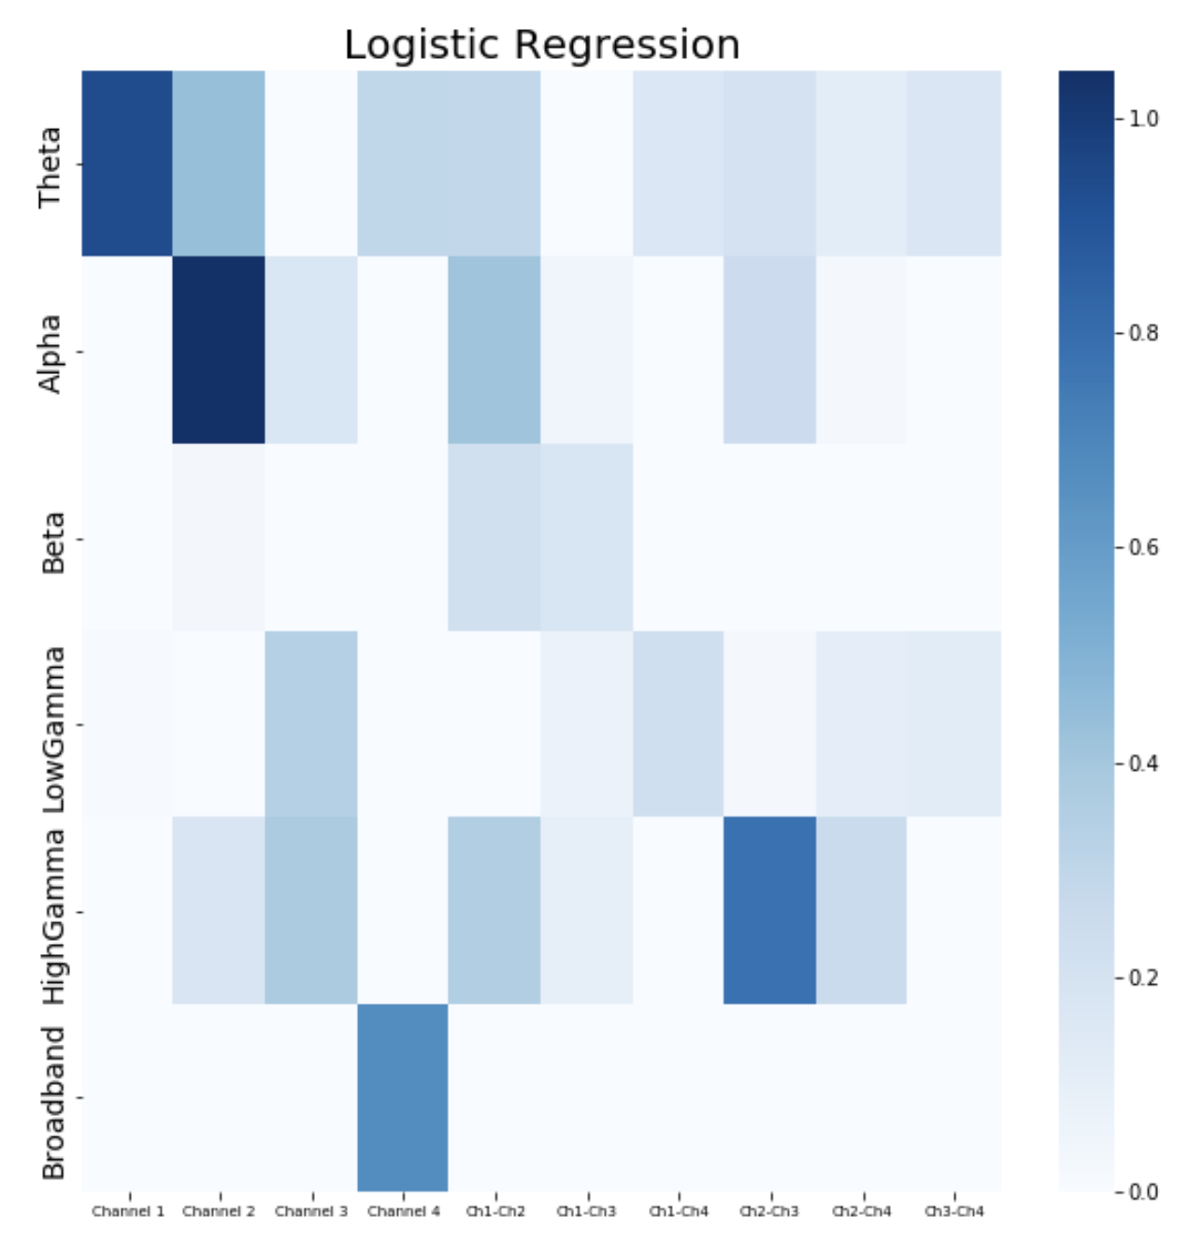
NY241 With PLV features – feature importance, LR & GB – ONLY SLEEP DATA

Slide 12
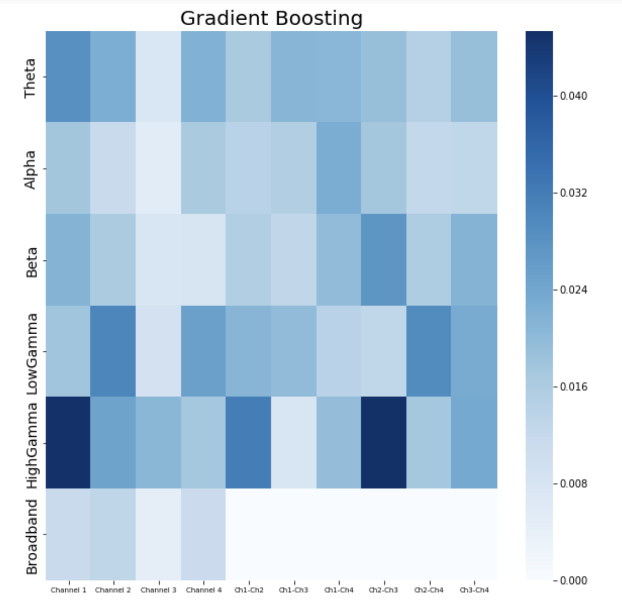
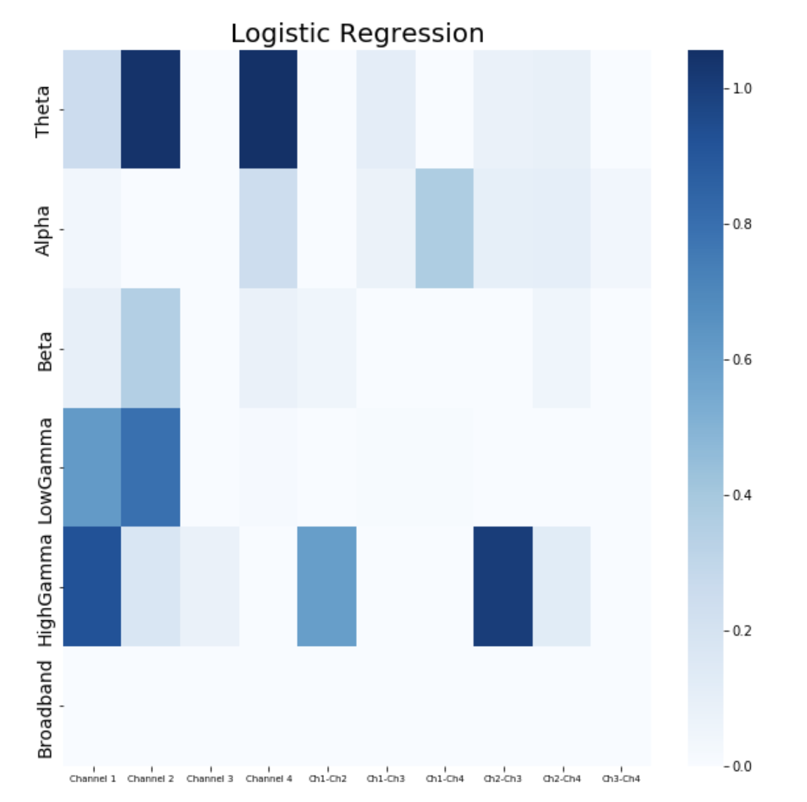
NY241 With PLV features – feature importance, LR & GB – ONLY AWAKE DATA

